Slide 1
.NET
Beginner Level (Session 2)

Slide 2
Overview
Recap last session
Web Fundamentals
ASP.NET Core Deeper Introduction
Deeper Intro into Project Structure
Deeper Intro into routing
Razor Syntax
Tag Helpers
Serving static files (wwwroot)
User Management Project
Preparing Project

Slide 3
Last Session
Course Overview
.NET Into
ASP.NET Core Intro
My First ASP.NET Core App

Slide 4

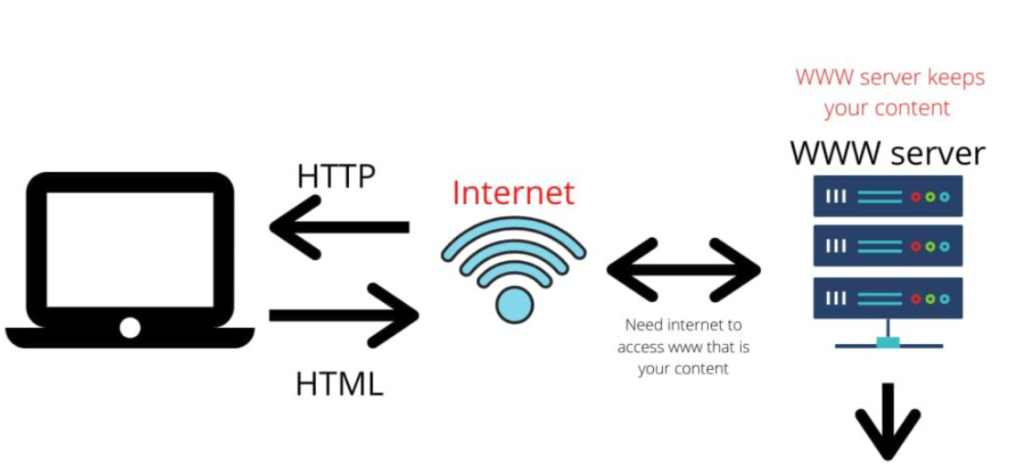
Web Fundamentals
HTTP / HTTPS
Client – Server Architecture
DNS

Slide 5
HTTP
Hypertext Transfer Protocol
Everything is transferred in the plain text
Client – Server Model
Stateless Protocol
HTTP Verbs
HTTP Status Codes

Slide 6
HTTP Status Codes
Serve as a standardized way for a web server to communicate the status of a request to the client
When that all goes according to plan the server returns a 200 code
Status codes specs are set by the W3C

Slide 7
HTTP Status Codes
1xx (Informational)
100 Continue
2xx (Successful)
200 OK
3xx (Redirection)
301 Moved Permanently
4xx (Client Error)
404 Not Found
5xx (Server Error)
500 Internal Server Error

Slide 8
HTTP VERBS
HTTP verbs are used to specify the action that a client wants to perform on a resource located on a web server
HTTPGET
HTTPPOST
HTTPPUT
HTTPDELETE
…

Slide 9

HTTPS
Hypertext Transfer Protocol Secure
Encrypts data using SSL/TLS
Public & Private Key Concept
Recommended for all websites to ensure user trust

Slide 10
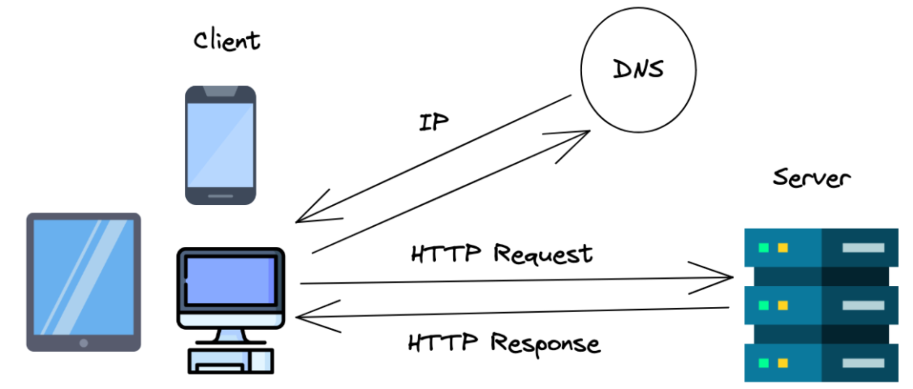
Client – Server Model
Request-Response Interaction
Resource Centralization
Clients are responsible for initiating requests, processing user inputs, and presenting information to users, while servers handle resource management, request processing, and service provision

Slide 11
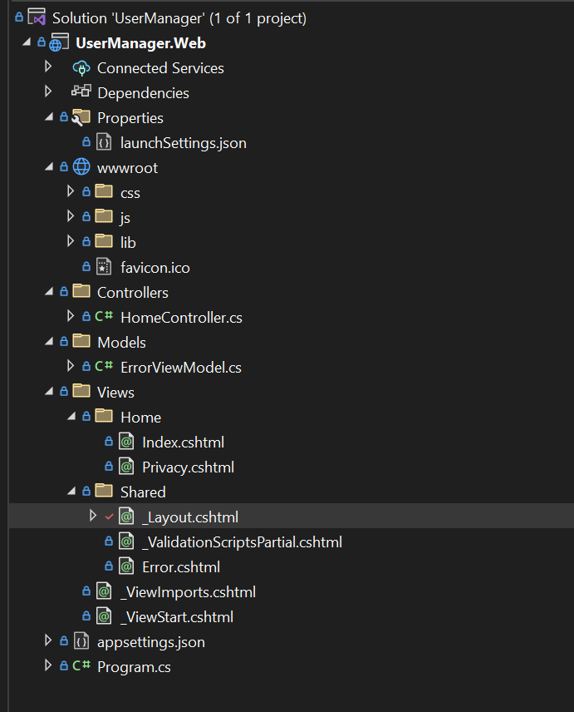
ASP.NET Project Structure
appsettings.json
Controllers & Actions (Endpoints)
Views
Model
wwwroot

Slide 12
appsettings.json
Centralized Configuration
Environment-Specific Configuration
Flexible and Hierarchical
Dynamic Reloading

Slide 13
Model
Data Representation
Business Logic
Validation
Data Access

Slide 14
Controllers & Actions
Handling User Requests
Request Routing
Mapping User Input to corresponding class

Slide 15
View
Ends with .cshtml extension
Serve as the presentation layer, responsible for rendering the user interface
Based on Razor Syntax
Uses Razor View Engine for rendering server components into HTML and bind data to it
Tag Helpers

Slide 16
View
RenderBody
RenderSection
DefineSection
IsSectionDefined
IgnoreSection
EnsureRenderedBodyOrSections

Slide 17
_ViewStart.cshtml
More maintainable and consistent ASP.NET Core MVC applications by centralizing view configuration
Code Reuse
Ensures a consistent look and feel across the website, as all views rendered will use the settings defined in _ViewStart.cshtml unless explicitly overridden
Simplifying View Creation
Hierarchical Configuration

Slide 18
Layout
Common Structure
Reusable Components
Centralized Style and Script References
Dynamic Content Rendering
Efficiency in Development
Easy to Update and Maintain

Slide 19
_ViewImports.cshtml
Define Common Directives
Reduce Code Duplication
Simplify View Creation
Layered Configuration

Slide 20
ViewData & ViewBag & TempData
ViewData is a dictionary-like object provided by ASP.NET Core MVC for passing data from controllers to views
ViewData is a loosely-typed collection, which means that the keys and values can be of any type
Values stored in ViewData must be cast to the appropriate type when accessed in views
ViewData["Key"] = value

Slide 21
ViewData & ViewBag & TempData
ViewBag is a dynamic property similar to ViewData but with a more convenient syntax for accessing data
Unlike ViewData, ViewBag uses dynamic properties to store and access data, eliminating the need for explicit casting
ViewBag is primarily used for passing simple data or temporary values from controllers to views
ViewBag.Key = value

Slide 22
ViewData & ViewBag & TempData
TempData allows you to store data that needs to be preserved for a short duration, usually from one HTTP request to another
It's particularly useful when you need to pass data between different actions during a redirect operation
TempData is designed to persist data for a single HTTP request. It's stored in the server's session state and is available until it's read or until the session expires
TempData["Key"] = value

Slide 23
Razor Syntax
Integration of Server-Side Code and HTML
Traditional ASP.NET development often involved mixing HTML and server-side code using <% %> syntax, which could lead to cluttered and less readable code
Strongly Typed Views
Consistency and Maintainability
It encourages separation of concerns by keeping presentation logic separate from business logic, which leads to cleaner and more modular codebases

Slide 24
Tag Helpers
Tag Helpers in ASP.NET Core enrich HTML tags with server-side features, making Razor views cleaner and more intuitive
Uses HTML-like attributes to trigger server-side behaviors, making views easier to read and maintain compared to traditional @Html helpers
Starts with asp-*
@addTagHelper *, Microsoft.AspNetCore.Mvc.TagHelpers (this is needed in order to use tag helpers in the razor views)

Slide 25
Usage of Tag Helpers
Form Generation
Link Generation
Cache and Environment Tag Helpers
View, Partial View, and Section Tag Helpers

Slide 26
Advantages of Using Tag Helpers
Enhanced Readability
Rich IntelliSense Support
Customization and Extension

Slide 27
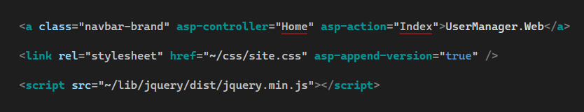
Link Generation Tag Helpers
<a> Generates links tied to action methods in controllers
<link> Helps manage stylesheet references.
<script> Assists in managing script file references.

Slide 28
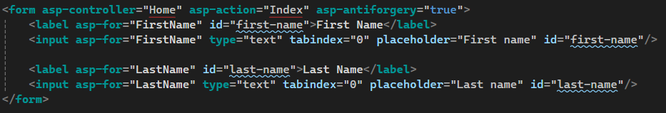
Form Generation Tag Helpers
<form> Enhances HTML form creation with routing and anti-forgery tokens
<input> Binds HTML input elements to model properties
<textarea> Binds a <textarea> element to a model property
<select> Binds a <select> dropdown list to a model property
<label> Associates an HTML label element with a model property
<validation-message> Displays validation messages for model properties
<validation-summary> Summarizes validation errors in a single block

Slide 29

Cache and Environment Tag Helpers
<cache> Caches content fragments to improve page load times
<distributed-cache> Similar to <cache>, but for distributed caching scenarios
<environment> Conditionally renders content based on the hosting environment (e.g., Development, Staging, Production)

Slide 30
View Components & Partial Views Tag Helpers
<partial> Renders partial views into the main view

Slide 31
Routing Deeper Intro
URL Mapping
Convention-based and Attribute-based Routing

Slide 32
wwwroot
Static File Storage
Publicly Accessible
Serving Static Content
Organization of Assets
Security Considerations

Slide 33

QA?

Slide 34
Thank you

